Slide 1
Singular Value Decomposition(SVD)

Slide 2
Singular Value Decomposition(SVD)
Solve matrix system of equation Ax=b ,for non-square matrix A ( particularly used in regression model)
Extract most important features
Can be used basis for PCA for dimensionality reduction
Feature extraction algorithms such as Principal component analysis (PCA) depend on the concepts of Eigenvalues and Eigenvectors to reduce the dimensionality of data (features) or compress the data (data compression) in form of principal components while retaining most of the original information.
Used in recommendation system
Many more applications

Slide 3
Why Matrix Decomposition
In order to understand a thing or problem in a better manner, we tend to break down things into smaller components and understand the things’ properties by understanding these smaller components.
Let’s take another example of an integer 18. In order to understand the integer, we can break down or decompose the integer into its prime factors such as 2 x 3 x 3. We get to know the properties of the integer 18 such as the following:
Any multiple of 18 is divisible by 3.
18 is not divisible by 5 or 7

Slide 4
Why Matrix Decomposition
Similarly, Matrices can be broken down or decomposed in ways that can show information about their functional properties that are not obvious from the representation of the matrix as an array of elements. One of the most widely used kinds of matrix decomposition is called eigen-decomposition, in which we decompose a matrix into a set of eigenvectors and eigenvalues.
In simple words, the concept of Eigenvectors and Eigenvalues are used to determine a set of important variables (in form of a vector) along with scale along different dimensions (key dimensions based on variance) for analyzing the data in a better manner.

Slide 5
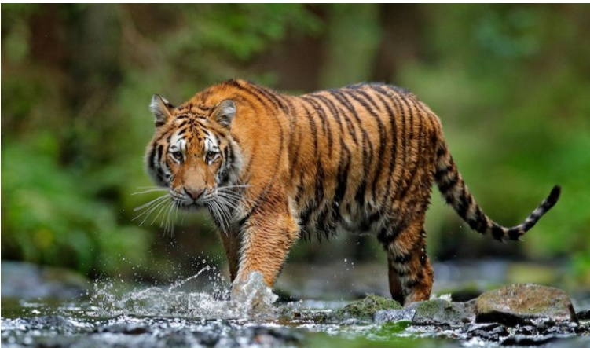
Eigen Vectors and Values
Principle components of the tiger are body, face, legs, etc information. These principal components/dimensions can be seen as eigenvectors with each one of them having its own elements.
For example, the body will have elements such as color, built, shape, etc. The face will have elements such as nose, eyes, color, etc.
The overall data (image) can be seen as a transformation matrix. The data (transformation matrix) when acted on the eigenvectors (principal components) will result in the eigenvectors multiplied by the scale factor (eigenvalue). And, accordingly, you can identify the image as the tiger.

Slide 6
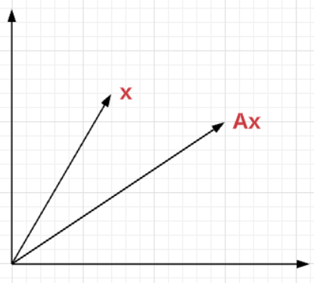
Eigenvectors are the vectors that when multiplied by a matrix (linear combination or transformation) result in another vector having the same direction but scaled (hence scaler multiple) in forward or reverse direction by a magnitude of the scaler multiple which can be termed as Eigen value. In simpler words, the eigen value can be seen as the scaling factor for eigenvectors. Here is the formula for what is called eigen equation.
Ax=λx

Slide 7
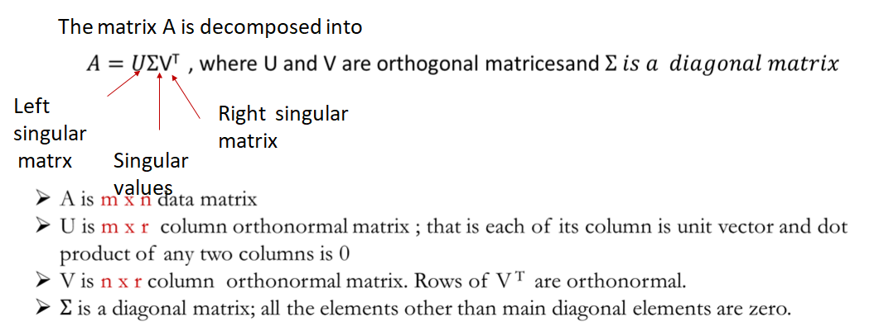
Computation of SVD

Slide 8
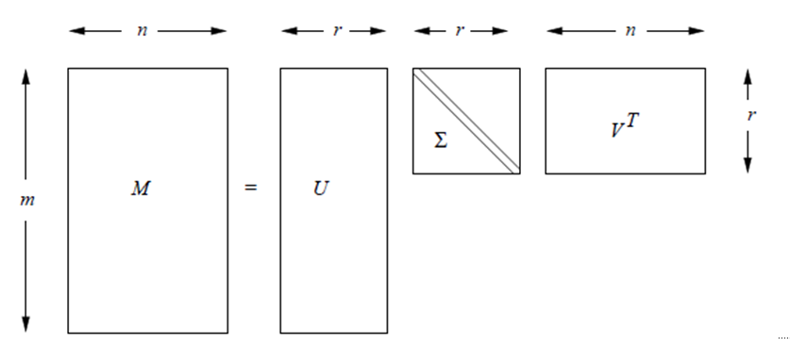
SVD

Slide 9
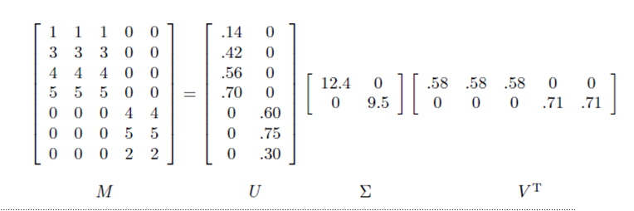
SVD (Example)

Slide 10
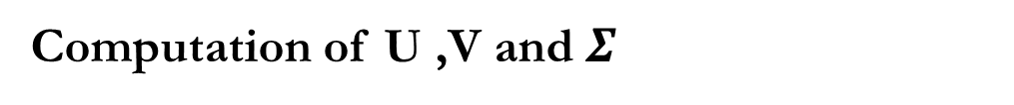
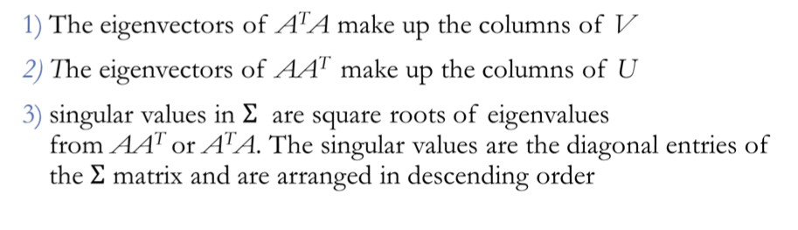

Slide 11
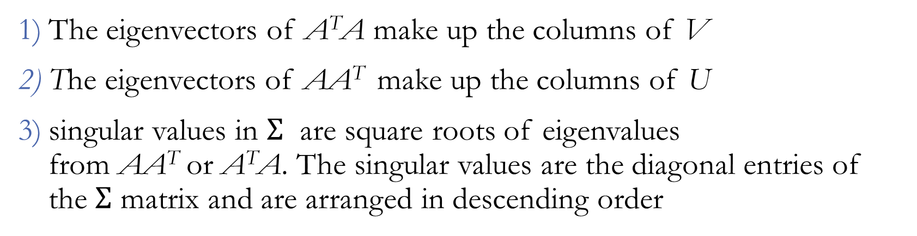


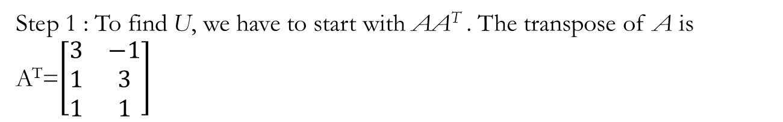
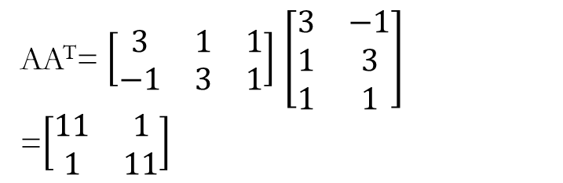
Example
Compute SVD decomposition of Matrix
Step 2 : Find eigen values and corresponding eigen vectors of AA^{T} .

Slide 12
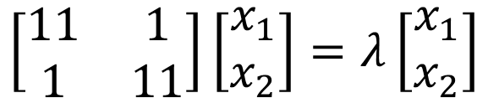
Step 2 : Find eigen values and corresponding eigen vectors of AA^{T} .
eigenvectors are defined by the equation A⃗v = λ⃗v, and applying this to AA^{T} gives :
rewrite this as the set of equations
11x₁ + x₂ = λx₁
x₁ + 11 x₂ = λ x₂
Rearranging this equation to
(11 − λ) x₁ + x₂ = 0
x₁ + (11 − λ) x₂ = 0

Slide 13
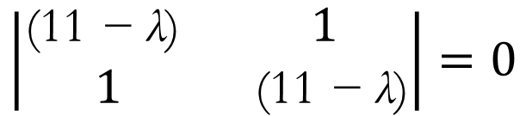
Solve for λ by setting the determinant of the coefficient matrix to zero,
(11 − λ)(11 − λ) − 1 · 1 = 0
(λ − 10)(λ − 12) = 0
λ = 10, λ = 12
Substitute λ back in to the original equations to compute eigenvectors.
For λ = 10
(11 − 10)x1 + x2 = 0
x1 = −x2, which is true for lots of values, so we'll pick x1 = 1 and x2 = −1
Thus, we have the eigenvector [1,−1] corresponding to the eigenvalue λ = 10.

Slide 14
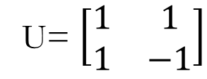
For λ = 12
(11 − 12)x1 + x2 = 0
x1 = x2
Choose x1 = 1 and x2 = 1. for λ = 12 we have the
eigenvector [1, 1].
The eigen vector corresponding to the largest eigen value will be the first column in the matrix and the second largest value in the second column.
The Matrix U has to be orthogonal.
A matrix U is orthogonal, if U.U^{T}=I
Step 3: convert this matrix into an orthogonal matrix by applying the Gram-Schmidt orthonormalization process

Slide 15
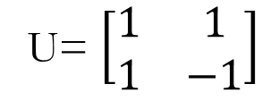
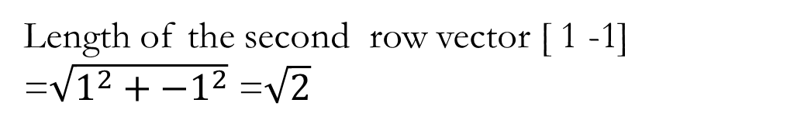
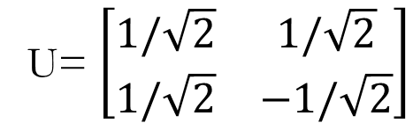
Step 3: convert this matrix into an orthogonal matrix by applying the Gram-Schmidt orthonormalization process to the column vectors
Divide each component in the row vector by its length, hence

Slide 16
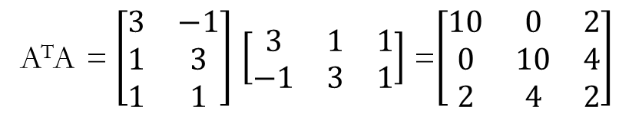
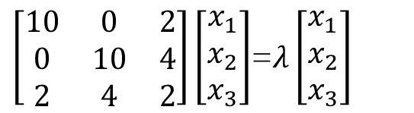
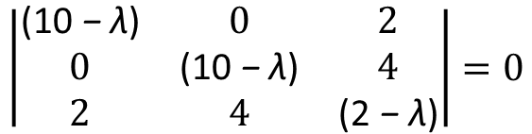
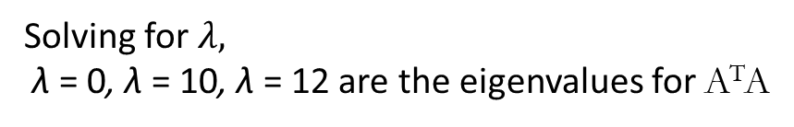
The calculation of V is similar. V is based on A^{T}A, so we have
which rewritten as
(10 − λ) x₁ + 2 x₃ = 0
(10 − λ) x₂ + 4 x₃ = 0
2x1 + 4 x₂ + (2 − λ) x₃ = 0
Find the eigenvalues of A^{T}A by
which are solved by setting
which represents the system of equations
10x₁ + 2x₃ = λx₁
10x₂ + 4x₃ = λx₂
2x₁ + 4 x₂ + 2x₃ = λx₃
λ(λ − 10)(λ − 12) = 0,

Slide 17
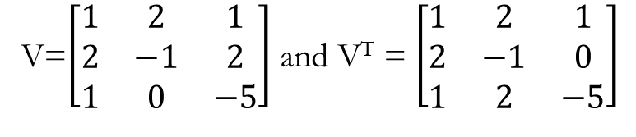
Substituting λ back into the original equations to find corresponding eigenvectors
For λ = 0
10x1 + 2x3 = 0
x3 = −5
10x1 − 20 = 0
x2 = 2
2x1 + 8 − 10 = 0
x1 = 1
So for λ = 0, ⃗v3 = [1, 2,−5].
for λ = 12
(10 − 12)x1 + 2x3 = −2x1 + 2x3 = 0
x1 = 1, x3 = 1
(10 − 12)x2 + 4x3 = −2x2 + 4x3 = 0
x2 = 2x3
x2 = 2
So for λ = 12, ⃗v1 = [1, 2, 1].
Order ⃗v1, ⃗v2, and ⃗v3 as column vectors in a matrix
according to the size of the eigenvalues
For λ = 10 we have
(10 − 10)x1 + 2x3 = 2x3 = 0
x3 = 0
2x1 + 4x2 = 0
x1 = −2x2
x1 = 2, x2 = −1
So for λ = 10, ⃗v2 = [2,−1, 0].

Slide 18
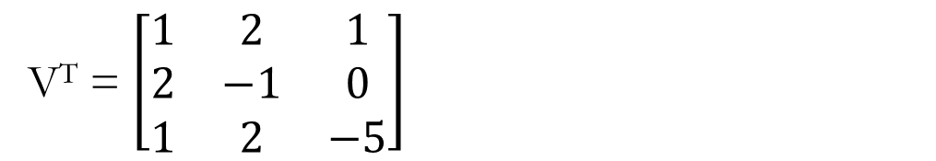
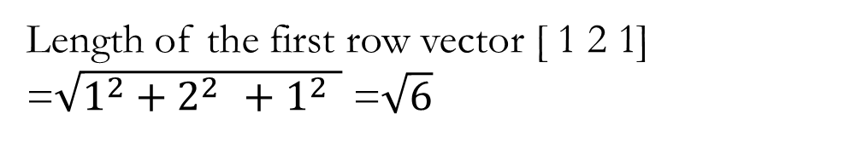
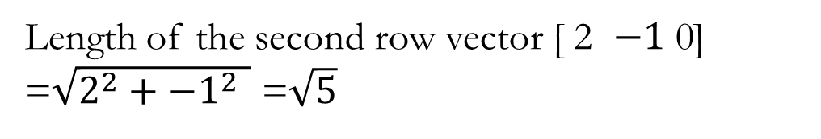
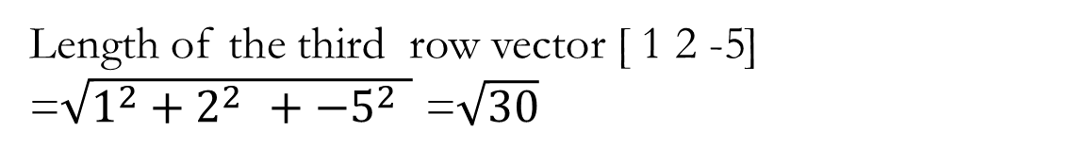
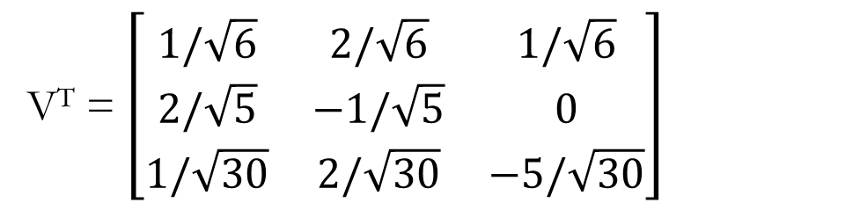
convert this matrix V^{T} into an orthogonal matrix by applying the Gram-Schmidt orthonormalization process
Divide each component in the row vector by its length, hence

Slide 19
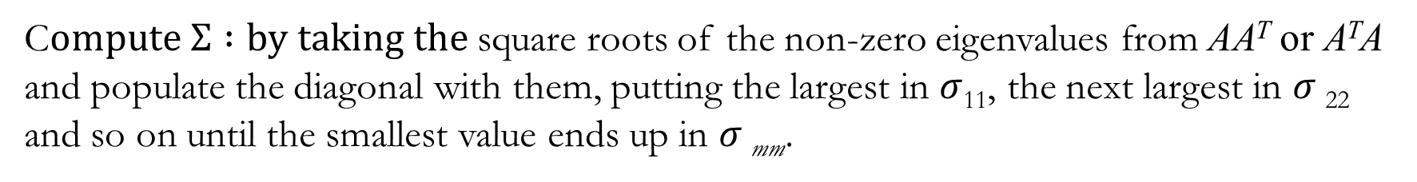
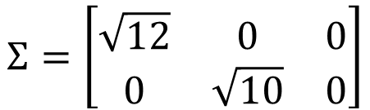

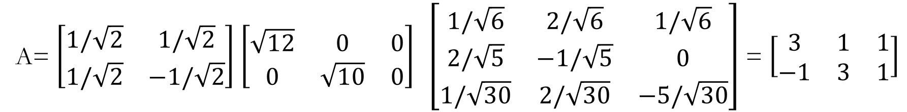

Slide 20
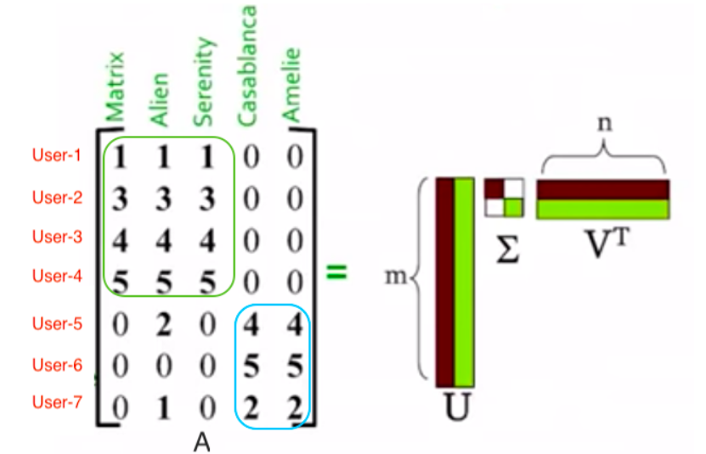
Dimensionality Reduction (SVD)
Consider Users to Movies matrix.
Let’s say we are Netflix or a user review website and we have a matrix that consists of users (rows) and movies (columns). User-based on their interest would have watched and rated a set of movies that they have seen.
A value of 1 depicts they did not like the movie and 5 represents that they really liked the movie.
Sci-fi movies
Non Sci-fi movies

Slide 21
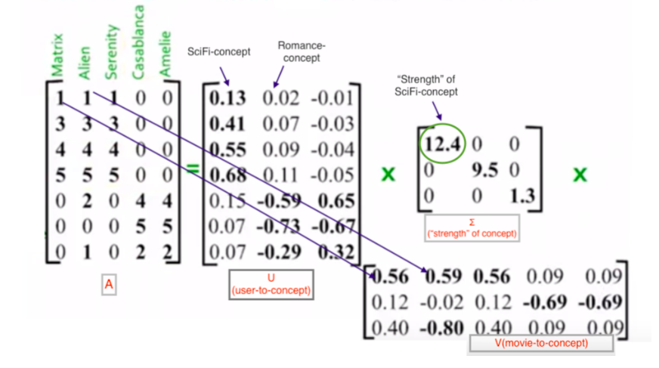
Dimensionality Reduction (SVD)
Here movies can be broken down into two groups Sci-fi and Non-Sci-fi and also users can be grouped down into Sci-fi lovers and Non-Sci-fi lovers. After applying Singular Value decomposition the resultant matrices can be shown below

Slide 22
Dimensionality Reduction (SVD)
Left Singular Matrix (U): Columns of matrix U can be thought of as concepts, the first column of U corresponds to the SciFi concept and the second column of U corresponds to the Romance concept (non-SciFi) .
What it basically shows is first 4 users correspond to scifi concept and the last 3 users correspond to romance concept. Matrix U would be “Users-to-Concept” similarity matrix.
Each value in matrix U determines how much a given user corresponds to a given concept (in our case there are two concepts, SciFi and romance concept).
In the given matrix for eg, the first user corresponds to SciFi-concept whereas the fifth user corresponds to romance-concept.

Slide 23
Dimensionality Reduction (SVD)
Singular Values (Σ): In this diagonal matrix, each diagonal values are non zero positive value. Each value depicts the strength of every concept. For instance, it can be seen “strength” of SciFi concept is higher than that of romance concept.
Right Singular Matrix (V): V is a “movie-to-concept” matrix. For instance, it shows that first three movies heavily belongs to the first concept i.e. SciFi concept while last two belongs to second concept which is romance concept.
There third concept but as we can notice the strength of third concept is too poor that we can ignore it and is nothing but the noise in our data.

Slide 24
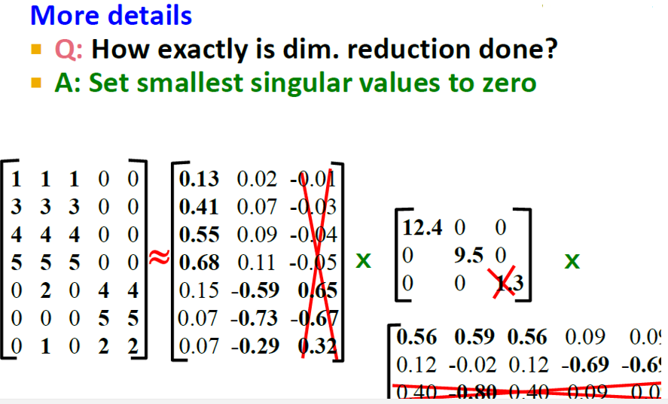
Dimensionality Reduction (SVD)

Slide 25
References
https://www.machinelearningmindset.com/linear-independence-of-vectors/
https://vitalflux.com/why-when-use-eigenvalue-eigenvector/
https://web.stanford.edu/~boyd/vmls/
http://pi.math.cornell.edu/~mec/Winter2009/RalucaRemus/Lecture3/lecture3.html
Linear Algebra for Machine learning – Javatpoint
https://datajobs.com/data-science-repo/SVD-Tutorial-[Kirk-Baker].pdf
https://medium.com/@antriksh_66433/dimensionality-reduction-singular-value-decomposition-727426d3b063

